Slide 1
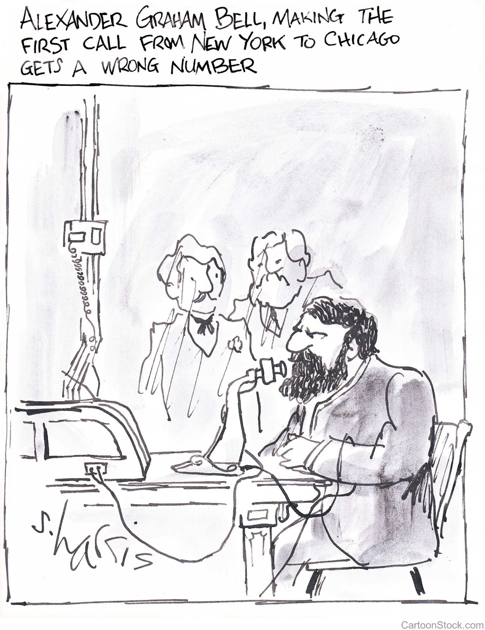
Super smartphones!
Starter
When the telephone was first used in the late 1800s, people were amazed that you could talk to someone through a wire.
Just imagine what they would think of all the things our smartphones can do now!
Think of all the things that smartphones can do.
You have one minute!

Slide 2

Starter
Smartphones have a whole host of different functions, which means you don’t need to carry around individual items.
E.g. Calendars, calculators.
How many of these can you come up with?

Slide 3



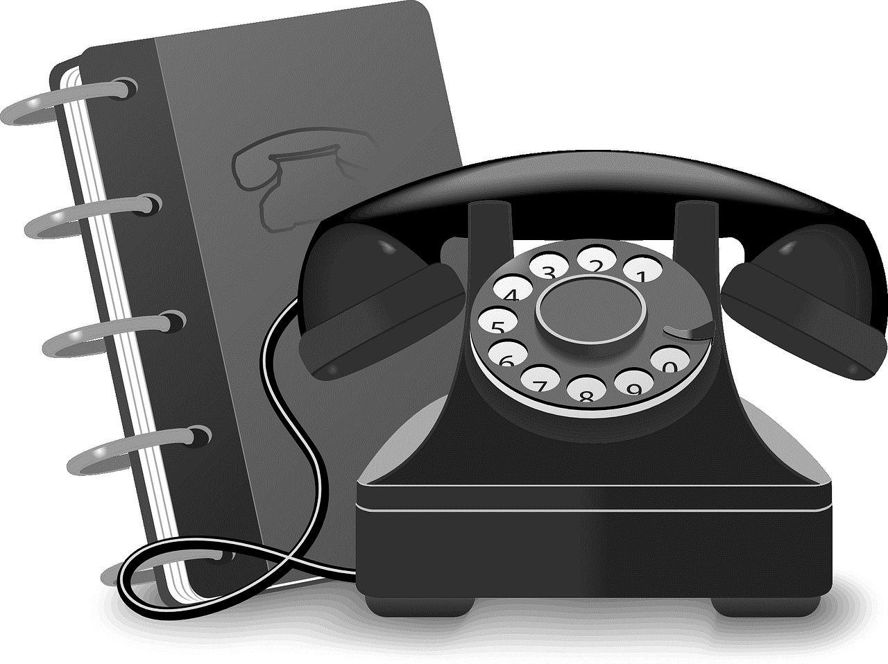
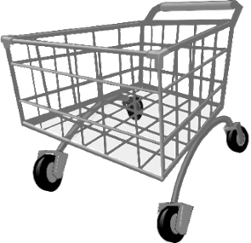
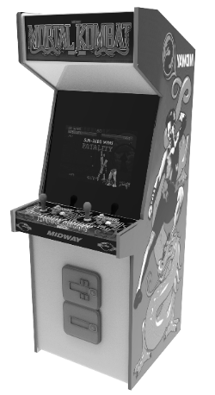



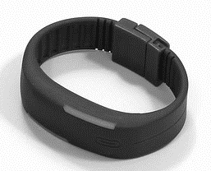
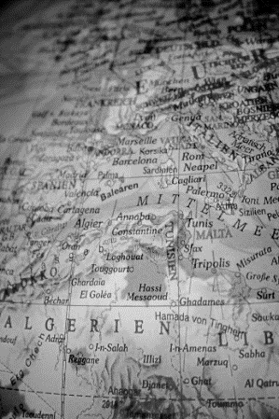
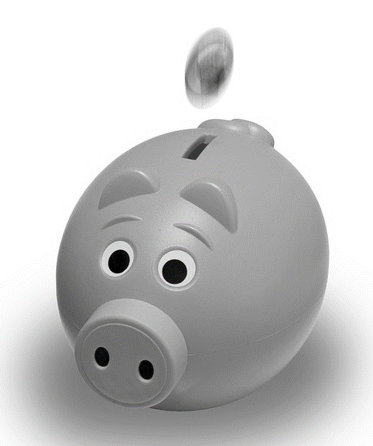

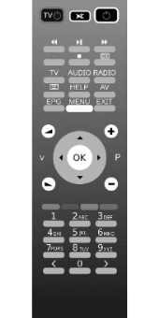
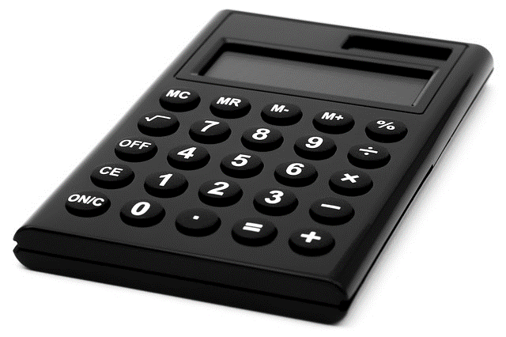
Starter
Notes:
All images sourced from Pixabay - pixabay.com
Bank (piggy) - © Joshua Willson licensed under CCO - https://pixabay.com/en/piggy-bank-coin-pink-piggy-bank-1056615/
Newspaper - © OpenClipart-Vectors licensed under CCO - https://pixabay.com/en/newspaper-article-journal-headlines-154444/
Remote control - © OpenClipart-Vectors licensed under CCO - https://pixabay.com/en/remote-control-receiver-vcr-control-2029564/
Map - © markusspiske licensed under CCO - https://pixabay.com/en/globe-africa-europe-continents-map-599486/
Calculator - © AlexanderStein licensed under CCO - https://pixabay.com/en/calculator-solar-calculator-count-168360/
Music (headphones) - © GDJ licensed under CCO https://pixabay.com/en/abstract-art-audio-aural-ear-2027961/
TV - © Clker-Free-Vector-Images licensed under CCO - https://pixabay.com/en/monitor-screen-flat-lcd-black-32743/
Notepad - © Open Clipart Vectors licensed under CCO - https://pixabay.com/en/notepad-memo-pencil-writing-note-117597/
Money - © ScouserUK licensed under CCO - https://pixabay.com/en/currency-money-coin-cash-wealth-2317703/
Calendar © Vectorstall licensed under CCO - https://pixabay.com/en/calendar-schedule-day-diary-2872749/
Photo album © Elkaaaaaa licensed under CCO - https://pixabay.com/en/birthday-company-candles-smiles-3016615/
Shopping Trolley © Open Clipart Vectors licensed under CCO - https://pixabay.com/en/caddy-shopping-cart-shopping-trolley-161016/
Newspaper © Open Clipart Vectors licensed under CCO - https://pixabay.com/en/newspaper-article-journal-headlines-154444/
Camera © Clker free vector images licensed under CCO - https://pixabay.com/en/camera-digital-portable-cam-32871/
Weather Forecast © Open icons licensed under CCO - https://pixabay.com/en/warm-sunny-cloudy-clouds-sun-98534/
Clock © Open clipart vectors licensed under CCO - https://pixabay.com/en/clock-analog-time-watch-147257/
Games © Gamezona licensed under CCO - https://pixabay.com/en/slot-machine-game-slot-jackpot-3053491/
Address Book © Open clipart vectors licensed under CCO - https://pixabay.com/en/book-phone-telephone-communication-159880/
Radio © Redquasar licensed under CCO - https://pixabay.com/en/boombox-ghetto-blaster-audio-player-2138198/
Pedometer © hayabuzo licensed under CCO - https://pixabay.com/en/bracelet-plastic-wrist-sports-1502602/

Slide 4

Starter
Lesson:
Being smart with your smartphone
What we’ll learn today:
To understand that it is possible for you spend real money through a smartphone
To identify situations that will cost you real money and those that will not
To understand what you can do in these situations and where to get help and advice

Slide 5
Starter
Bill shock
What might give people a shock when they look at their phone bill?
Bill shock is a term used to describe when somebody gets a nasty surprise in their phone bill or when their credit goes down without them expecting it.
People should know when they are spending money through their phone bill or credit.

Slide 6
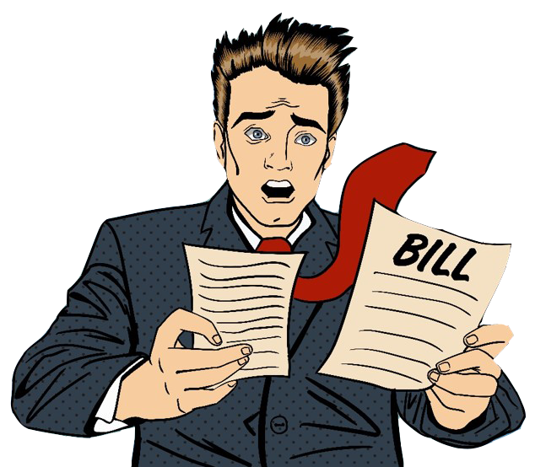
Don’t worry. Help is at hand!
Starter
There is someone who can help you and warn you if you could spend real money through a phone.
His name is Bill Shock.
Bill Shock is here to give you advice and warn you if you are about to do something that could cost real money now or in the future.
You will see Bill every so often in the presentation.
Be careful
out there
kids!

Slide 7
Activity 1
Activity 1
BILL SHOCK
What to do:
Look at all the information on the slide.
If you think this could cost real money, now or in the future, hold up your Bill Shock sign.
Remember:
You are not expected to know all the answers.
Adults can make mistakes with these too ☺
THIS COULD COST
REAL MONEY

Slide 8
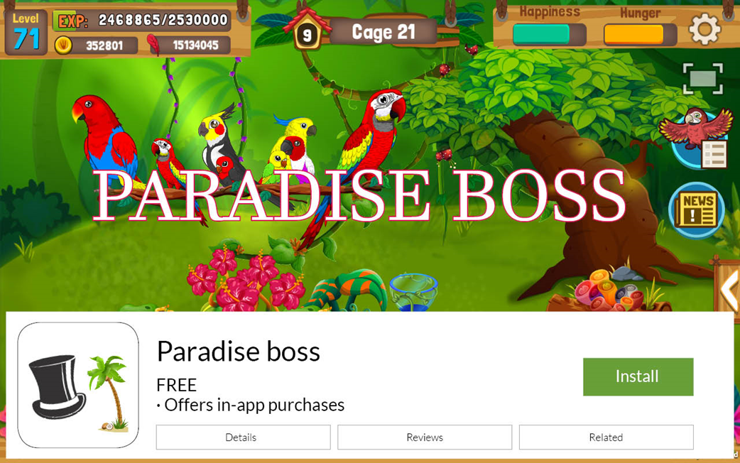

Could this cost real money now or in the future?
Activity 1
Hi there. Although the app is FREE it has something called in-app purchases.
In-app purchases are things you buy with real money in the game – it may be for an extra level, new tool or to buy a helpful map.
Be careful out there and see you later.

Slide 9

Could this cost real money now or in the future?
Activity 1
This will not cost you any money to call as it is a 0800 number which is a freephone number.
But remember donating money would involve spending real money.
TO DONATE
Call us free on
0800 12 24 66

Slide 10

Could this cost real money now or in the future?
Activity 1
Sending a text to 898762
or calling 09 numbers
are not free!
Ask the bill payer before
using them.

Slide 11
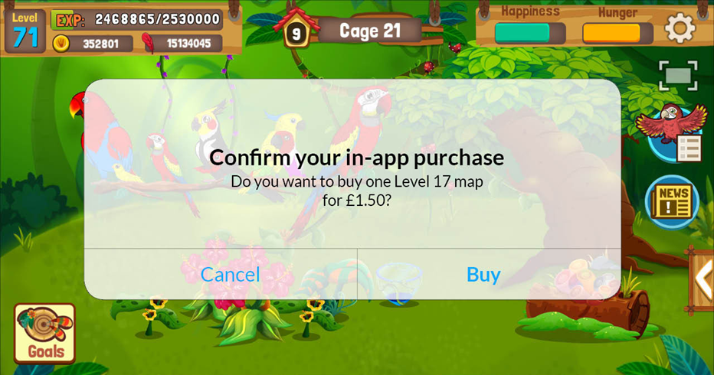
Could this cost real money now or in the future?
Activity 1
Careful!
This is one of those
in-app purchases
I warned you about.
Well done if you spotted it.

Slide 12

Could this cost real money now or in the future?
Activity 1
It will cost money to send the text, but often you can enter the vote for free through their website.

Slide 13
Activity 1
Stop and think
What have you learnt from Bill Shock?
What would you like to know more about?
What questions do you still have?

Slide 14
Activity 2
Activity 2: Reading can save you money
What to do:
1. Underline the key words.
2. Tick the box to say if this is something that could cost money or is free.
3. Explain your decision.
✓
The first three months are free but it will cost £10 per month afterwards.
TIP: If you are not sure about any words or phrases then please use Bill Shock’s
Words you need to know card from your pack.

Slide 15
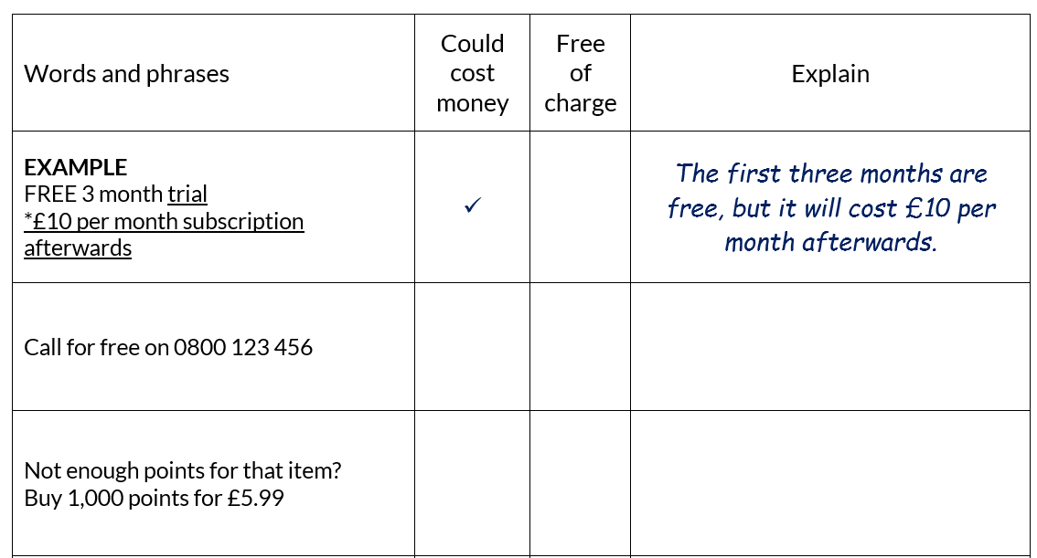
Activity 2
Example:

Slide 16
Activity 2
Answers:
Ads | Cost | Answers
Call for free on 0800 123 456 | Free | 0800 numbers are free but it is always best to check if you are not sure.
Not enough points for that item? Buy 1,000 points for £5.99 | Will cost £5.99 | If you buy this item it will add £5.99 to your phone bill or take £5.99 from your phone credit.
Subscribe to our weekly newsletter | Should be free | There is no mention of a cost or buying the newsletter.
To win text your answer to 612345 *Texts will be charged at 50p | Will cost 50p | The small print at the bottom tells you that you will be charged 50p to send the text. Some texts are covered by your contract but this one is not.
Joining fee | Will cost money | Joining fees will cost real money. You would need to find out what the fee is now and in the future.
Download the app for free today with in-app purchases | Could cost money | Downloading and playing the game is free but can you can buy things in the app with real money.

Slide 17
Activity 2
Stop and think
Why don’t we always read the small print?
Why might the small print or terms and conditions (T&Cs) not be clear to a child?

Slide 18
Activity 3
Activity 3: What could go wrong?
Now it‘s time to put your new knowledge to use!
You will look at some situations and answer the questions.
REMEMBER: If you are not sure about any words or phrases then please use Bill Shock’s Words you need to know card from your pack.

Slide 19
Aaisha
Activity 3
Aaisha and her friends have all been playing a free game called Globe Ball. As you play the game, you earn points. There are new levels and features the further you go.
Aaisha is way ahead of her friends and she is rather sad when she realises she is playing the last level. Luckily, when she completes the level she is really pleased to find out that that there are bonus levels.
On the screen it says “Want to go to the bonus levels? 5 GBP for the next level.” Aaisha has lots of points on Globe Ball so she clicks on the BUY button. She starts playing but notices that she has not lost any points. Aaisha thinks that there is a problem with the game and keeps on playing and buying new levels. The next day she tries to make a call but her phone has no credit, even though she only topped up 3 days ago.
What do you think has happened?
What should Aaisha do now?
What should Aaisha do in the future?

Slide 20
Jordan
Activity 3
Jordan is watching a TV show and wants to vote for his favourite group to win. He asks his parents if he can vote by calling the number but his mum says no because the calls and texts cost money.
When the group finish their final song Jordan sees an advert for the TV show’s free app. Jordan downloads the app because it says ‘vote for free’.
Jordan votes 5 times but then it stops him and says he cannot vote again. Jordan asks his mum to download the app and votes on her phone too.
His favourite band wins the show but his mum is not very happy when she checks Jordan’s and her own phone bill a month later!
Why have they been charged?
What should Jordan and his mum have done?
What can they do now?

Slide 21
Eliza
Activity 3
Eliza is browsing the internet on her iPhone and sees an ad for online dance and fitness classes. She clicks on the link to see what it’s about and when she’s done she realises she can’t close the ad.
The only thing she can tap on her screen is the ‘Subscribe’ button so she taps on it hoping that will get rid of the ad. She is then prompted with page that says ‘Welcome’ and has details on how to reply STOP to unsubscribe, but she closes it without looking at it.
Now Eliza is receiving every week a text message saying she’s been billed £3 to her phone bill and details on how to cancel this. She ignore them thinking she’s not used the service so why would she be billed?
Is Eliza right to ignore the messages?
Should Eliza text ‘STOP’ to stop the app sending her messages?

Slide 22
Matas
Activity 3
Matas’s little brother is 6 and loves Monster Trucks. Matas likes to show his little brother videos and pictures on the family tablet. One day they see an advert for a Monster Truck game called Monster Marvels. Matas checks the age rating and notices that the game is free so he downloads it. Matas also notices you can chat on the game, so he turns this off and tells his parents about the game. His little brother loves Monster Marvels and is doing really well.
He shows Matas a new truck he bought that is really fast and Matas shows him that he can add better tyres and nitro boosts to make the truck go even faster. Matas makes sure he is always around when his brother is on the tablet and they sometimes watch each other playing games.
A week later Matas’s mum is really shocked and confused when she finds 5 payments of £19.99 on her phone bill. She assumes it is Matas and starts to tell him off, but he tells her it can’t be him.
How can you spend money on a free game?
What else could Matas have done before downloading the game for his little brother?
Is there anything that Matas’s parents could have done to stop this happening?

Slide 23
Nana
Activity 3
Nana has been given his first phone. He has a contract with a small amount of data, minutes and texts. Nana is very sensible and asks his dad before downloading apps. They look up any apps they are not sure about to keep Nana safe.
Nana sees a music app that has a free trial and wants to download it. Nana and his dad read the terms and conditions. It says “Free for the first 2 months and £2 per month subscription afterwards. Minimum subscription 12 months. We reserve the right to increase our prices.” His dad agrees but reminds Nana that he needs to set a reminder of when to cancel the trial so that he does not start paying.
Nana gets the reminder before the end of his free trial but is unsure what to do as he really likes the app.
How much will it cost Nana if he cancels now?
How much will it cost Nana if he uses the app for the next 2 months but then cancels it?
Do you think Nana should keep the app?

Slide 24

Revision
What have you learnt today?
Create a top tips poster to help others avoid any bill shocks or accidentally spending real money.
Your poster should:
Have at least 3 top tips
Be clear and well presented
Be aimed at young people aged 8-11 years old
Think…
Is it always clear if something is going to cost money or pay-as-you-go credit?
What words should you look for in order to know if something is going to cost money?
What can people do to avoid bill shock?
What should someone do before spending any money on their phone?

Slide 25



This lesson was created by us, the Phone-paid Services Authority in collaboration with Childnet International.
The Phone-paid Services Authority is the UK regulator for content, goods and services charged to a phone bill or pay-as-you-go credit. They include directory enquiries, voting on TV talent shows, donating to charity by text or downloading apps on your mobile phone.
www.psauthority.org.uk
www.phonebrain.org.uk
Childnet International is a non-profit organisation, working with others around the world to help make the internet a safe place for children. Childnet works directly with children and young people from the ages of 3 to 18, as well as parents, carers, teachers and professionals, finding out about their real life experiences online, and the positive things they are doing as well as sharing safety advice. Working directly with these audiences, they develop resources and respond to policy issues to make children and young people safer. At the heart of all their work is the belief that when used properly the internet is a wonderfully positive tool for children and young people.
www.childnet.com
Childnet International is part of the UK Safer Internet Centre.

