Slide 2

National Curriculum: Year 2
Children need to develop:
pleasure in reading;
motivation to read;
increased vocabulary;
improved level of understanding.
While in year 2, children must add to this by learning about
cause and effect in:
narrative texts, e.g. What has prompted
the character’s behaviour in this story?
non-fiction texts, e.g. Why are certain dates
commemorated annually?
This skill requires deep thinking and is easier for some children than others.
Notes:
Review the National Curriculum aims for year 2, highlighting the importance of motivating children to read both at school and at home.
Highlight some methods of supporting parents with motivating children to want to read.
You may wish to mention the use of a reading reward chart to help children to get into good reading habits.
Ensure that parent and carers also understand that a number of the skills needed will be developed by hearing adults read to them, not just necessarily by reading texts themselves. Discuss the impact of reading texts to children at a higher level than they can read for themselves in order to develop their vocabulary and understanding.

Slide 3

How to Help
In everyday life, model explaining why you have made the decisions you have made, e.g. ‘I’m going to leave that there so that I remember it later.’
Continue to regularly model clear reading with
fluency and expression.
Share your opinions about a book and explain why you think that.
Discuss appropriate national events and explain why they are celebrated annually.
Explain why people react the way they do within certain social situations.
Notes:
Cover some initial ideas of how parents and carers can support the aims highlighted on the previous slide.
These ideas are also included in the Reading with Your Year 2 Child Parent Advice Booklet.

Slide 4

Year 2 Expectations
Year 2 children are expected to:
use a range of strategies to read new words, e.g. breaking the word down into chunks;
read familiar words quickly without needing to sound them out;
correct themselves when they have read a sentence incorrectly;
read words containing the common suffixes –ful (careful),
-ly (slowly), -ness (illness), -ment (treatment) and –less (helpless);
Notes:
These elements of the National Curriculum are expanded upon for parents and carers in the Reading with Your Year 2 Child Parent Advice Booklet.

Slide 5

Year 2 Expectations
Year 2 children are expected to:
continue to practise phonics until reading has become fluent;
retell a story, referring to most of the key events and characters;
decide how useful a non-fiction text is for a particular purpose;
be aware that books are set in different places;
relate what they have read to their own experiences;
Notes:
These elements of the National Curriculum are expanded upon for parents and carers in the Reading with Your Year 2 Child Parent Advice Booklet.

Slide 6

Year 2 Expectations
Year 2 children are expected to:
continue to build up a repertoire of poems learnt by heart;
recognise key themes and ideas within a text;
make simple inferences about the thoughts and feelings of characters and the reasons for their actions.
Notes:
These elements of the National Curriculum are expanded upon for parents and carers in the Reading with Your Year 2 Child Parent Advice Booklet.

Slide 7
Year 2 Common Exception Words
Notes:
Share the Year 2 Common Exception Words handout and explain that pupils need to be able to read and spell these words by the end of the year.

Slide 8
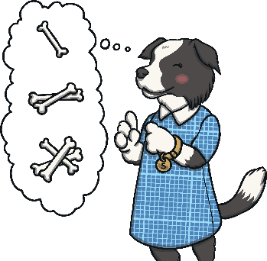

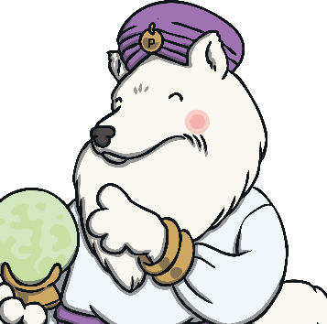

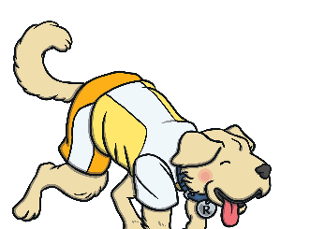
SATs Content Domain Coverage
In the KS1 reading tests, your child’s understanding of reading is tested through five different strands, known as ‘content domains’.
These content domains are:
Inference Iggy
Content Domain 1d:
Make inferences from the text.
Vocabulary Victor
Content Domain 1a:
Draw on knowledge of vocabulary to understand texts.
Sequencing Suki
Content Domain 1c:
Identify and explain the sequence of events in texts.
Predicting Pip
Content Domain 1e:
Predict what might happen on the basis of what has been read so far.
Rex Retriever
Content Domain 1b:
Identify/explain key aspects of fiction and non-fiction texts such as characters, events, titles and information.
Getting your child used to answering questions from each of these content domains prepares them for the SATS reading assessment. Asking a few questions per night will build your child’s experience.
Notes:
Introduce parents and carers to the Year 2 SATs using the Totally Pawsome Gang to cover each content domain.

Slide 9
Vocabulary
Vocabulary Victor will help your child to explore how and why authors and poets have chosen to use certain words and phrases.
Vocabulary Victor
Content Domain 1a:
Draw on knowledge of vocabulary to understand texts.
What does this word/sentence tell you about…
(fiction feature/non-fiction subject matter)?
Can you find a word/sentence that tells you…/ shows you…/backs up what you have said about…?
Why did the author use the word… to describe…?
How does this word/description make you feel?

Slide 10
Retrieval
Rex Retriever will help your child to delve into a text and
retrieve the facts exactly as they are written.
Rex Retriever
Content Domain 1b:
Identify/explain key aspects of fiction and non-fiction texts such as characters, events, titles and information.
Where/when is the story/poem set?
Is this character a good/bad character?
How can you tell?
Is there a dilemma in the story? What is it?
How is the dilemma resolved?
Find your favourite description of the…

Slide 11
Sequencing
Sequencing Suki likes everything in order!
She will help your child to sequence events in a text and to
discuss the order in which things happen.
Sequencing Suki
Content Domain 1c:
Identify and explain the sequence of events in texts.
How/where does the story/poem/non-fiction
text start?
Which character do we meet first?
What is the first/second/last step in
these instructions?
Put these sentences into the order they happened in.

Slide 12
Inference
Inference Iggy will help your child to hunt for clues in a text about how someone might be feeling or why something is happening.
Inference Iggy
Content Domain 1d:
Make inferences from the text.
What do you think… is saying/thinking/feeling at this point? Why?
What do you think the author meant when…?
Why does the author use the word … here?
How do you think the author feels about …?
Find words to back this up.

Slide 13
Prediction
Predicting Pip tries to see the future and she will help your child to work out what might happen next based on what they have already read.
Predicting Pip
Content Domain 1e:
Predict what might happen on the basis of what has been read so far.
What do you think will happen next?
Where do you think … will go next? Why?
What might you expect to see in this sort of text?
Can you think of any other stories like this? How do they end? Do you think this will end the same way?

Slide 14

Brilliant Book List Y2
Notes:
Share the Brilliant Book List Y2. Highlight that these are only suggestions of books that might be good to read together with your child throughout the year and does not provide an exhaustive list. Explain that it is important for children to find and read books that they are interested in so that they want to become lifelong readers.

Slide 15

Helping Your Child at Home
Talk about what can be inferred from the pictures before you read the text, e.g. ‘Why might the girl on the cover be sad?’
Discuss alternative words the author could have used, e.g. ‘Happy is a bit of a boring adjective, isn’t it? What word could we use instead?’
Make predictions
and be able to
justify them.

Slide 16

Helping Your Child at Home
Discuss the setting of the story. Have you read another book with the same setting?
How does the setting in the first chapter differ to the setting at the end of the story?
Have you learnt
anything while reading this book that you didn’t
know before?

Slide 17


Reading Every Day
Reading to your child every day is just as important as hearing your child read to you.
Reading to your child will help your child to develop their understanding of what they hear. It can also inspire them to want to read for themselves.
Try to read to your child at a higher level than they can read
by themselves.
Remember to talk about new words you come across together.
Why not use a dictionary?

Slide 18

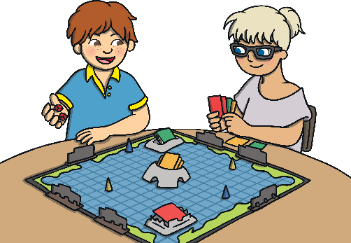
Reading Game Ideas
Playing simple reading games will help your child to see the relevance
of reading while having fun.
Play board games that include reading. Ask your child to read out the clues.
Notes:
Share some simple games and ideas that families can do together at home to inspire a culture of reading.

Slide 19

Reading Game Ideas
Playing simple reading games will help your child to see the relevance
of reading while having fun.
Ask your child to read menus, notices or posters when you are out and about.
Notes:
Share some simple games and ideas that families can do together at home to inspire a culture of reading.

Slide 20


Reading Game Ideas
Playing simple reading games will help your child to see the relevance
of reading while having fun.
What was the best thing about school today?
Hide notes with words or sentences on around the house.
Encourage your child to hunt for them and to read the notes that they find.
I love playing games.
Notes:
Share some simple games and ideas that families can do together at home to inspire a culture of reading.

Slide 21

Have you got any questions?

