Slide 1
Scheme or Service | Summary | Referral Form
Digital Inclusion | Free laptop, broadband (via dongle) and software for vulnerable and families in hardship | Referral Form
Talents and Interests | An adult from an education setting or community organisation can apply for a grant on the young person or group’s behalf in order to access hobbies such as sports, the arts or music. You can apply for £50 to £300 per grant for individuals and up to a £1000 for a group of three or more. | Talents and Interests grant scheme
KCC Fuel and Food Vouchers | Gov Household Support Fund: Food and fuel vouchers for eligible households. Please also check district level offer which may be different and or supplementary. New scheme due to go live, which will operate by professional referral. | HSF Food and energy
Cost of Living | Varies by district | Cost of Living Dartford
Cost of Living | Varies by district | Cost of living Gravesham
Cost of Living | Varies by district | Cost of living Swale
Energy Saving Advice | KCC are working with Green Doctor to provide energy saving advice. | Green Doctor
KSAS Fuel and Food | Kent Support and Assistance Service. Fuel and food only during Covid (reduced service to manage demand) | Home essentials in a crisis
Kent Together Helpline | Kent Together helpline is available to support vulnerable people in Kent who need urgent help with things like getting food or collecting prescriptions. | www.kent.gov.uk/KentTogether
County and National Support Tool | North Kent, County, National services and support information. Including financial support section | Kent and National Support Services
Hardship Resource Tool | Kent and national resources to support with the cost of living crisis | Hardship Help for Families in Kent
Salus Intensive Mentoring Service | Salus offer Intensive Mentoring to children and young people aged 8-18yrs across the whole of Kent. More info info@salusgroup.org.uk | Salus Mentoring
Young Lives Foundation Mentoring | Young people who are considered to be at risk of offending, socially excluded or in need of support can be referred for a YLF Mentor. Facilitated online gaming also available. | YLF Mentoring and Gaming

Slide 2
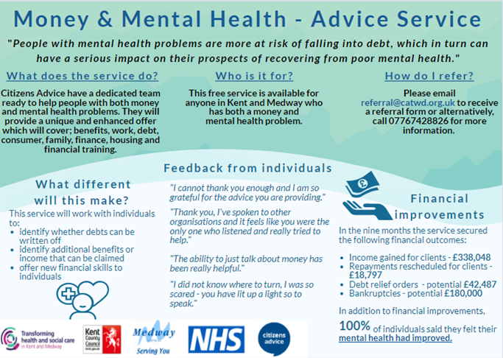
Catch22 – Commissioned CCE | Support children and young people up to the age of 25, who are at risk of child criminal exploitation (CCE) and county lines in Kent and Medway using both preventative and protective interventions (for those at risk of, and those involved in, serious youth violence respectively). | Kent County Lines and Gangs KentCCE.referrals@catch-22.org.uk
CAB Money and Mental Health Support | CAB Money and MH Service 03300533685. Referrals – referral@catwd.org.uk
ReferKent | Make and or receive referrals across Kent based agencies and providers | ReferKent - Kent County Council
Library Service – Cost of Living Support | Money advice, free support groups and library play sessions | Cost of Living Support | Kent Libraries
Kooth | Kooth is an online mental wellbeing community for all 10 – 25 year old’s in Kent. Kooth offers free online counselling and support including self-help tools, articles, journals, magazines, discussion boards, and access to fully trained counsellors online 365 days a year | Kooth.com - Kent Resilience Hub
ChatHealth | Chathealth confidential texting service for young people aged 11-19 will operate as normal. Young people can text the school health team about any concerns or health issues on 07520 618850. The number is monitored Monday to Friday, 9am to 5pm. Parents, young people and schools can access a range of helpful information and resources via the Kent Youth Website, please follow the link: https://www.kentyouthhealth.nhs.uk/ | ChatHealth | KCHFT
HAF Holiday Activities and Food | Families of children aged 4 to 16 years, who are in receipt of benefits related to free school meals, can access FREE opportunities during the Easter, summer and Christmas holidays throughout 2022/23. | HAF Kent
Child Mental Health Resources | Wide range of resources and services for children to support their emotional health and wellbeing | Child Mental Health Support

